Slide 1


Slide 2
Introduction
What is GPU?
It is a processor optimized for 2D/3D graphics, video, visual computing, and display.
It is highly parallel, highly multithreaded multiprocessor optimized for visual computing.
It provide real-time visual interaction with computed objects via graphics images, and video.
It serves as both a programmable graphics processor and a scalable parallel computing platform.
Heterogeneous Systems: combine a GPU with a CPU

Slide 3
GPU Evolution
1980’s – No GPU. PC used VGA controller
1990’s – Add more function into VGA controller
1997 – 3D acceleration functions:
Hardware for triangle setup and rasterization
Texture mapping
Shading
2000 – A single chip graphics processor ( beginning of GPU
term)
2005 – Massively parallel programmable processors
2007 – CUDA (Compute Unified Device Architecture)

Slide 4
GPU Graphic Trends
OpenGL – an open standard for 3D programming
DirectX – a series of Microsoft multimedia programming interfaces
New GPU are being developed every 12 to 18 months
New idea of visual computing:
combines graphics processing and parallel computing
Heterogeneous System – CPU + GPU
GPU evolves into scalable parallel processor
GPU Computing: GPGPU and CUDA
GPU unifies graphics and computing
GPU visual computing application: OpenGL, and DirectX

Slide 5
GPU System Architectures
CPU-GPU system architecture
– The Historical PC
– contemporary PC with Intel and AMD CPUs
Graphics Logical Pipeline
Basic Unified GPU Architecture
– Processor Array

Slide 6
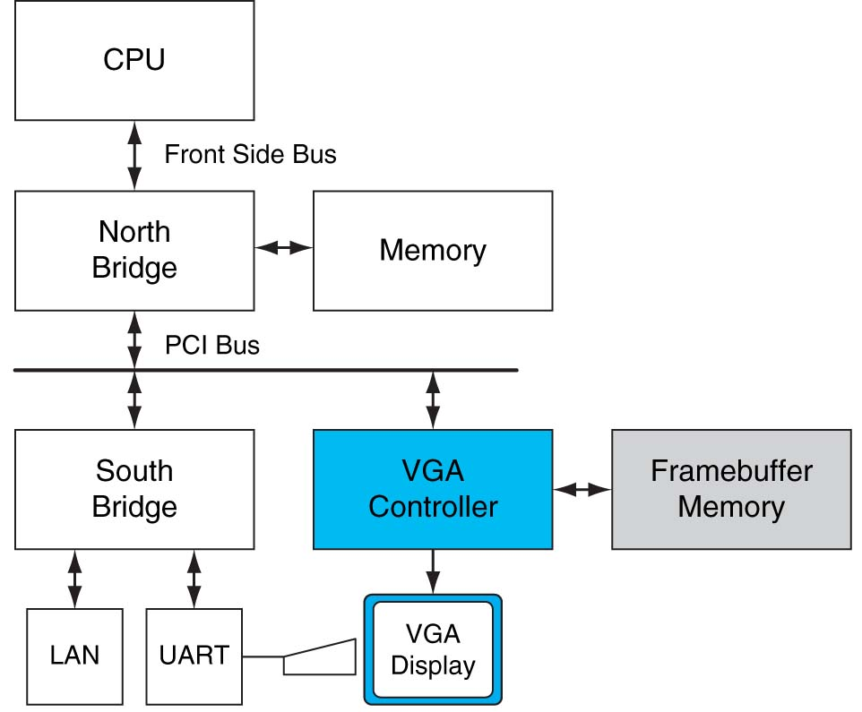
Historical PC
FIGURE A.2.1 Historical PC. VGA controller drives graphics display from framebuffer memory. Copyright © 2009 Elsevier, Inc. All rights reserved.

Slide 7
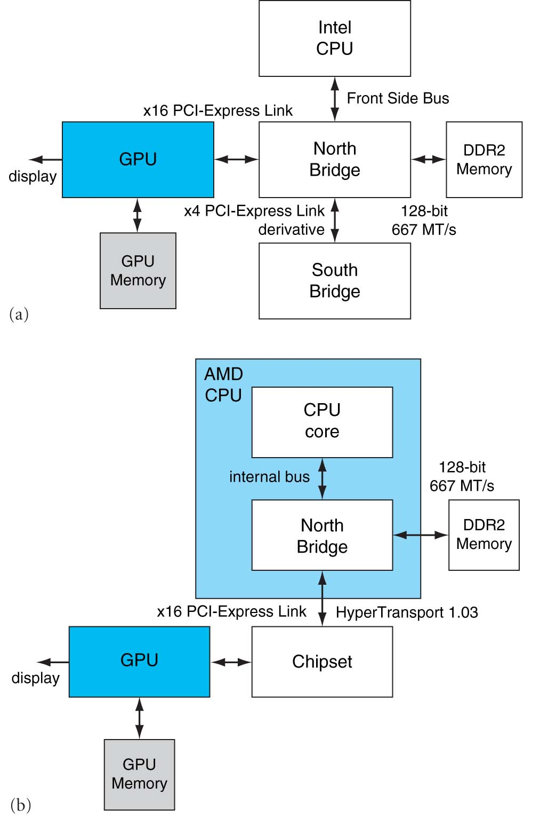
Intel and AMD CPU
FIGURE A.2.2 Contemporary PCs with Intel and AMD CPUs. See Chapter 6 for an explanation of the components and interconnects in this figure. Copyright © 2009 Elsevier

Slide 8
Graphics Logical Pipeline
FIGURE A.2.3 Graphics logical pipeline. Programmable graphics shader stages are blue, and fixed-function blocks are white. Copyright © 2009 Elsevier, Inc. All rights reserved.

Slide 9
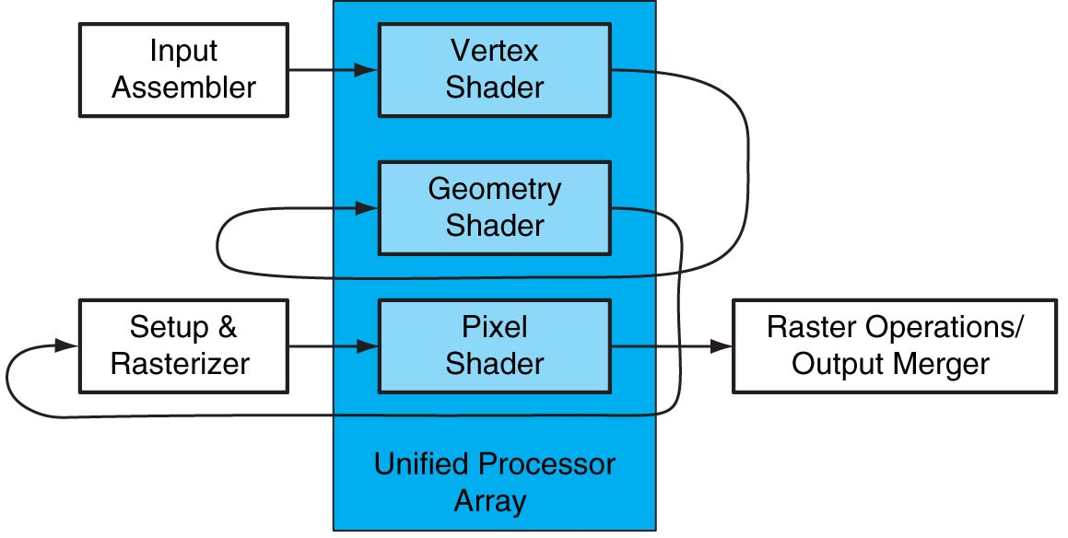
Basic Unified GPU Architecture
FIGURE A.2.4 Logical pipeline mapped to physical processors. The programmable shader stages execute on the array of unified processors, and the logical graphics pipeline dataflow recirculates through the processors. Copyright © 2009 Elsevier, Inc. All rights reserved.

Slide 10
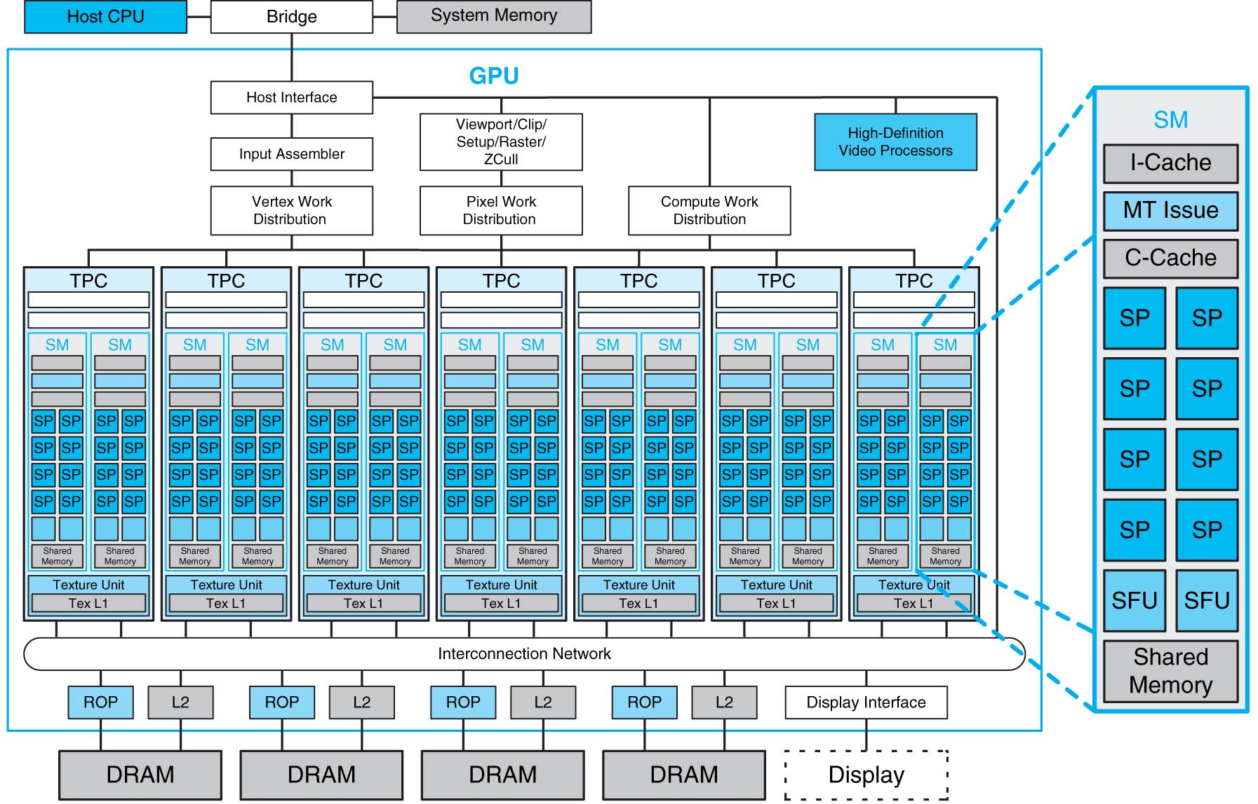
Processor Array
FIGURE A.2.5 Basic unified GPU architecture. Example GPU with 112 streaming processor (SP) cores organized in 14 streaming multiprocessors (SMs); the cores are highly multithreaded. It has the basic Tesla architecture of an NVIDIA GeForce 8800. The processors connect with four 64-bit-wide DRAM partitions via an interconnection network. Each SM has eight SP cores, two special function units (SFUs), instruction and constant caches, a multithreaded instruction unit, and a shared memory. Copyright © 2009 Elsevier, Inc. All rights reserved.

Slide 11
Compare CPU and GPU
Nemo-3D
Written by the CalTech Jet Propulsion Laboratory
NEMO-3D simulates quantum phenomena.
These models require a lot of matrix operations on very large matrices.
We are modifying the matrix operation functions so they use CUDA instead of that slow CPU.

Slide 12

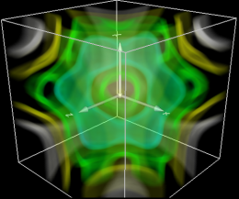
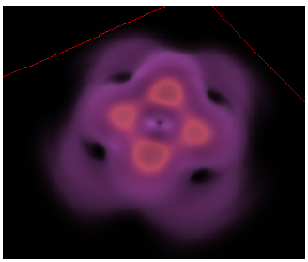
Nemo-3D
Simulation
Visualization
NEMO-3D
VolQD
Computation
Module
CUDA
kernel

Slide 13
Testing - Matrices
Test the multiplication of two matrices.
Creates two matrices with random floating point values.
We tested with matrices of various dimensions…

Slide 14
Results:
Dim\Time | CUDA | CPU
64x64 | 0.417465 ms | 18.0876 ms
128x128 | 0.41691 ms | 18.3007 ms
256x256 | 2.146367 ms | 145.6302 ms
512x512 | 8.093004 ms | 1494.7275 ms
768x768 | 25.97624 ms | 4866.3246 ms
1024x1024 | 52.42811 ms | 66097.1688 ms
2048x2048 | 407.648 ms | Didn’t finish
4096x4096 | 3.1 seconds | Didn’t finish

Slide 15
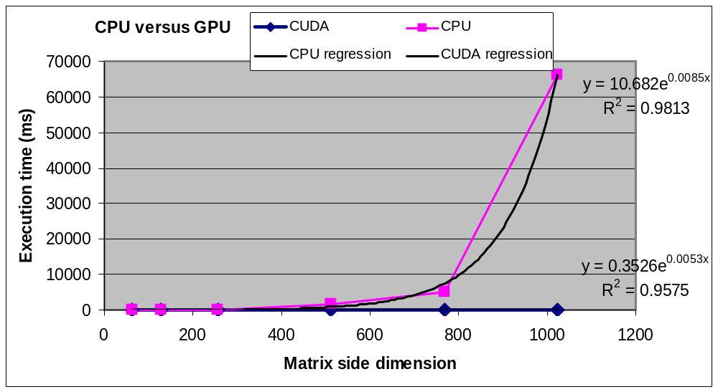
In visible terms:

Slide 16
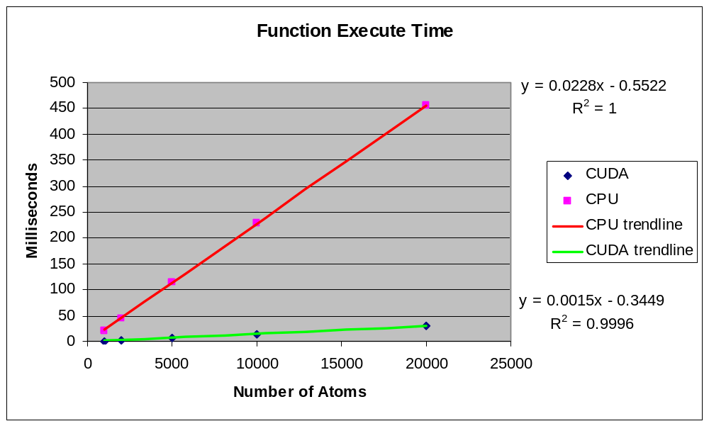
Test results:

